Slide 1

Prioritization: Circle of Influence and Concern
D7_S2_2.3
Unless otherwise indicated, this learning resource is
licensed CC-BY-NC. Please attribute NUEPA, New Delhi

Slide 2

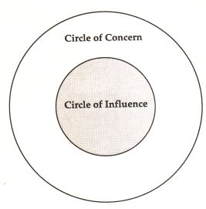
Prioritizing Problems
We have both – Our Circle of Concern and Our Circle of Influence

Slide 3
Prioritizing Problems
Circle Of Concern
Letting concerns overwhelm us will increase our Circle of Concern and reduce our Circle of Influence
Pointers:
Concerns Grow – Circle of Concern Occupies the Entire Circle!
Influence Diminishes to nearly Zero!
We only worry, can’t get anything done!

Slide 4
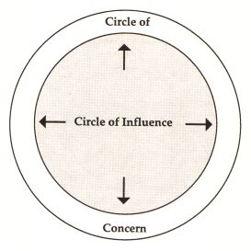
Prioritizing Problems
Working in our Circle of Influence will help it grow, making Concerns less worrisome and less Constraining
Pointers:
As we work in our Circle of Influence, Influence Increases and Concerns Diminish to a much Smaller Area

